Slide 1
Data Visualization
Session 5 – PL 300 Bootcamp

Slide 2
What is Data Visualization?
Data Visualization is the art of making Data Understandable & Impactful for
Analysts
Decision Makers
Storytellers
Our purpose is turning rows and columns into meaningful visuals - like charts, graphs and dashboards – to reveal insights and patterns.

Slide 3
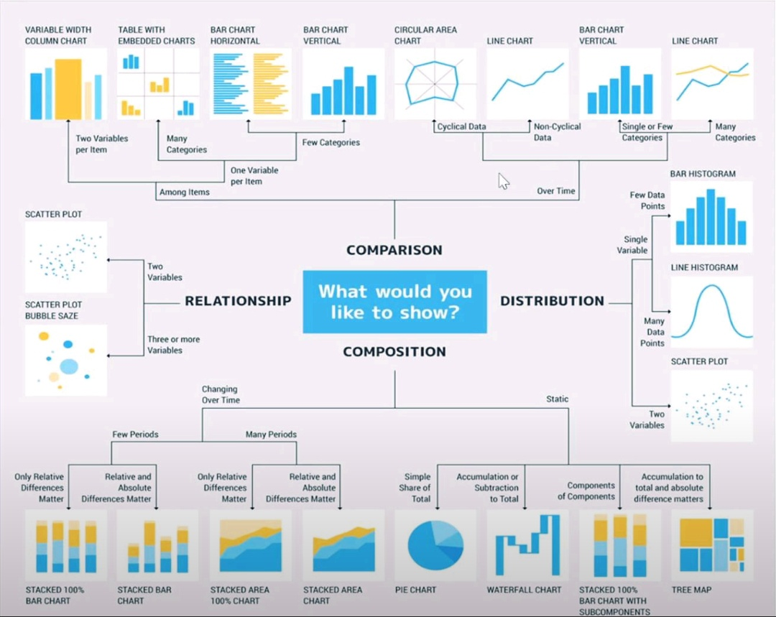
Common Charts Types and When to Use them?
Bar Chart:
Comparing categories(e.g., sales by region)
Line Chart :
Trends over time (e.g., monthly traffic)
Pie Chart :
Proportions (e.g., market share)
Scatter Plot :
Relationships & correlations (e.g., height vs weight)
Heatmap :
Density & intensity (e.g., user clicks)
Box Plot : Distribution & outliers

Slide 4
Designing and maintaining report.
DO’S
Identify Target Audience
Choose the Right Chart Type
Keep it Simple and Focused Minimize clutter.
Use Colors Purposefully.
Maintain Data Integrity.
Tell a Story
Organize visuals using Align feature
DON’TS
Don’t Overcomplicate
Don’t Mislead with Scales.
Don’t Use Inappropriate Chart Types
Don’t Rely Only on Color.
Don’t Ignore Context : provide Legends, Labels.
Don’t Clutter Your Visuals.

Slide 5

Filters & Bookmarks
Filter Types:
Visual-level: Apply to one visual.
Page-level: Apply to all visuals on a page.
Report-level: Apply across all pages.
Drillthrough: Navigate to filtered detail pages.
Cross-filtering: Interactions between visuals.
Bookmarks:
What they do: Save the current state of visuals, filters, and layout.
Navigation (simulate page links)
Toggle views (show/hide visuals)
Storytelling (step-by-step insights)

Slide 6

Sorting and Ordering
1. Basic Sorting:
Ascending/Descending: You can sort data in Power BI visuals either in ascending or descending order. This is applicable to both numerical and categorical data.
Single Column Sorting: By default, Power BI allows you to sort data based on a single column. You can click on the column header in a table or matrix visual to sort the data.
2. Multi-Column Sorting:
Power BI supports multi-column sorting, which allows you to sort data based on multiple fields. This is useful for more complex datasets where you need to prioritize sorting by one column and then by another (Hold Shift).
3. Custom Sorting:
Sort by Column: You can define a custom sort order using the "Sort by Column" feature. This is particularly useful for categorical data where the default alphabetical sorting doesn't make sense (e.g., sorting months chronologically).

Slide 7
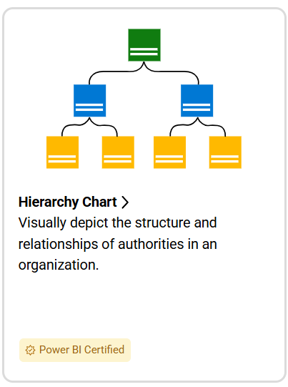
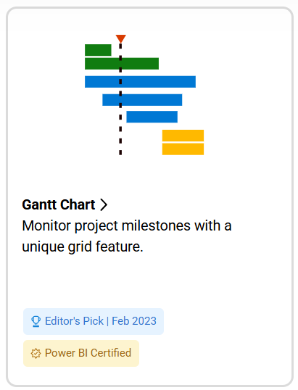
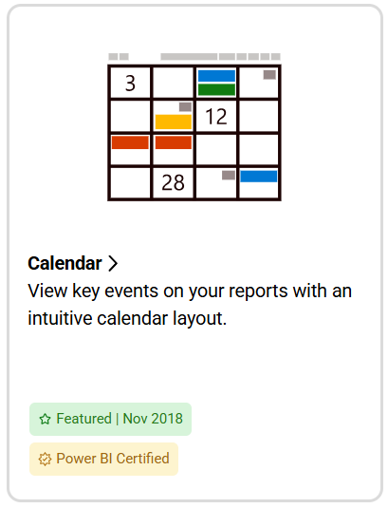
Custom Visuals in Power Bi
Custom visuals are user-defined visualizations that extend the capabilities of Power BI beyond the standard set of visuals provided by Microsoft. They allow users to tailor their reports to meet specific business needs and enhance data storytelling.
How to find and use custom visuals?
Open Power BI Desktop or the Power BI service.
Click the ellipsis (...) in the Visualizations pane.
Select "Get more visuals."
Browse or search for the desired visual.
Select the visual and click "Add."
The visual will be added to your report.
users should exercise caution and verify the source and trustworthiness of custom visuals before importing them.

